Slide 1
Multiple Testing Correction
Problem with running a large number of experiments, e.g. A/B Testing

Slide 2


Slide 3

Number of dice | Chance of getting 6
1 | 0.167
2 | 0.306
3 | 0.421
4 | 0.518
……
25 | 0.999

Slide 4
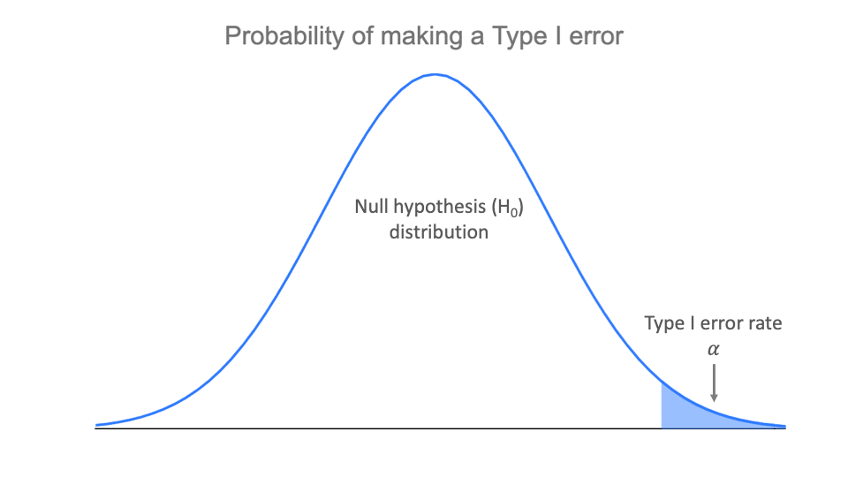
If you repeat the experiment will the probability be the same?

Slide 5
5% chance of error in 10,000 genes = 500 genes of false positive

Slide 6
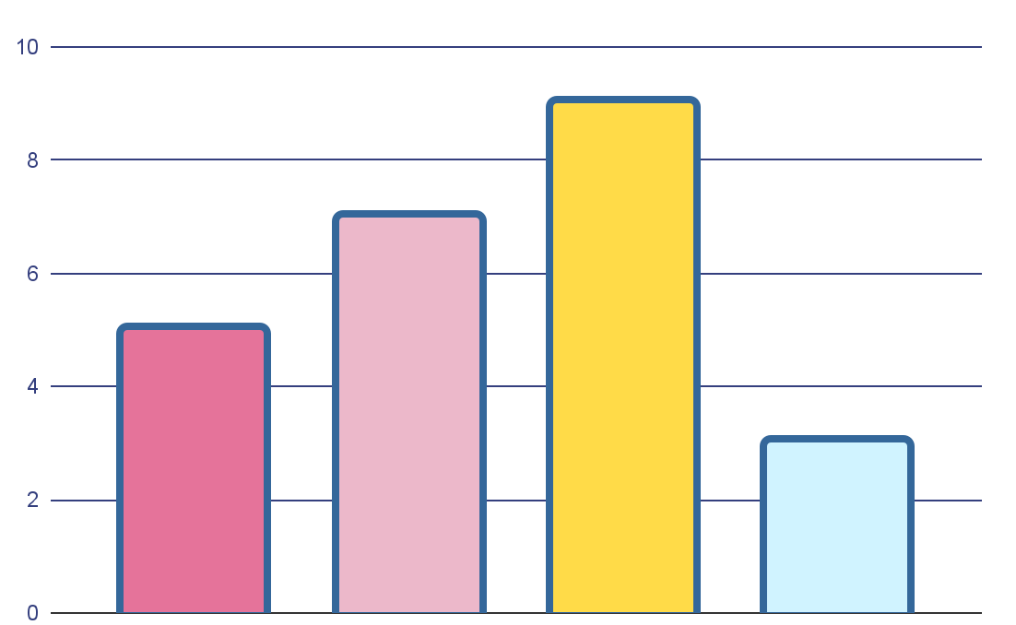
Multiple testing!
Gene | Gene1 | Gene 2 | Gene3
Gene 1
Gene 2 | √
Gene 3 | √ | √
Gene4 | √ | √ | √
Gene 1
Gene 2
Gene 3
Gene 4
We need 6 tests!

Slide 7

Familywise Error Rate
Formula
FWER for 6 tests
FWER = 1-(1-α)^{k}
1-(1-0.05)⁶ = 26.5%
FWER for 1 test
It is a problem!
FWER = 1-(1-0.05)¹ = 5%

Slide 8
Controlling the familywise error rate: Bonferroni correction
α/n
Example:
α/6 = = 0.05/6 =0.008
We only reject a null hypothesis if the p-value is less than 0.008
.

Slide 9
Familywise Error Rate
Formula
FWER for 6 tests
FWER = 1-(1-α)^{k}
1-(1-0.05)⁶ = 26.5%
FWER for 1 test
Corrected FWER for 6 tests
FWER = 1-(1-0.05)¹ = 5%
1-(1-0.05/6)⁶ = 4.9%

Slide 10
 | Gene | α =0.05 | α =0.008
1 | Gene 1 vs Gene 2 | 0.98 | 0.348
2 | Gene 1 vs Gene 3 | .012 | .111
3 | Gene 1 vs Gene 4 | .011 | .003
4 | Gene 2 vs Gene 3 | .0.36 | .493
5 | Gene 2 vs Gene 4 | 0.02 | .078
6 | Gene 3 vs Gene 4 | 0.028 | 0.234

Slide 11
Do you think Bonferroni correction( α/n) is good for testing 10,000 genes?

Slide 12
Type I error
Type II error

Slide 13
Type I error
Type II error

Slide 14
Controlling the false discovery rate: Benjamini-Hochberg procedure
i
1
2
3
4
variables | P value
A | 0.008
B | 0.039
C | 0.062
D | 0.071
(i/n)*Q
0.010
0.030
0.060
.0.071

Slide 15



Now, let’s play!

Slide 16


Summary!
You cannot repeat your experiment
Bonferroni very strict
BH more Powerful
using suitable p-value adjustment method
you can skip p-value adjustment method

Slide 17

References
McDonald, J. H. (2009). Handbook of biological statistics (Vol. 2, pp. 6-59). Baltimore, MD: sparky house publishing.‏ ] Retrieved from Multiple comparisons - Handbook of Biological Statistics (biostathandbook.com)
Goldman, M. (2008). Spring 2008-stat c141/bioeng c141-statistics for bioinformatics. Course Website.‏ ] Retrieved from Section0402.pdf (berkeley.edu)
McNamara, A. (2020). Correcting for multiple comparisons in R (STAT 320 week 10 video 5 of 5) [Video]. Retrieved from https://www.youtube.com/watch?v=pevqgRKjlk4

